Slide 1
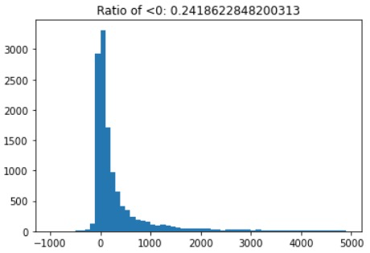
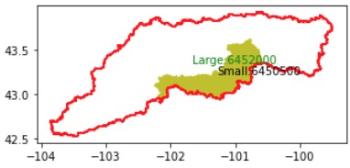
Q infile for the smaller basin: /glade/p/ral/hap/common_data/camels/obs_flow_met/basin_dataset_public_v1p2/usgs_streamflow/all/06450500_streamflow_qc.txt
Q infile for the larger basin: /glade/p/ral/hap/common_data/camels/obs_flow_met/basin_dataset_public_v1p2/usgs_streamflow/all/06452000_streamflow_qc.txt
It is possible that smaller basins may have larger streamflow than larger basins (e.g., very strong ET in the rest part of the larger basin). But how to split streamflow seems is not very clear. Should we allow negative streamflow or force negative values to be zero? Or should we use better streamflow splitting methods?

